Slide 1
“Loyalty to Love”
Revelation 2:1-7

Slide 2
Jesus’ Letters to the
7 Churches of Asia
Ephesus Rev. 2:1-7
Smyrna Rev. 2:8-11
Pergamos Rev. 2:12-17
Thyatira Rev. 2:18-29
Sardis Rev. 3:1-6
Philadelphia Rev. 3:7-13
Laodicea Rev. 3:14-22

Slide 3
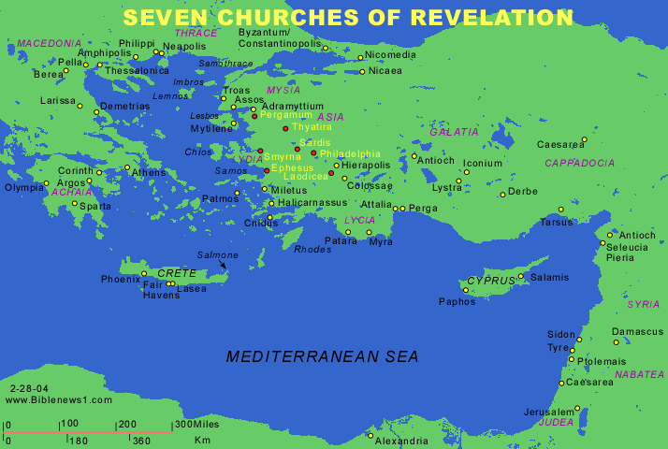

Slide 4
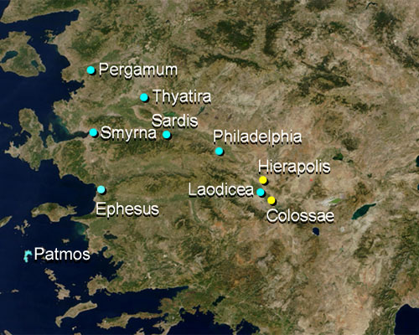

Slide 5
REVELATION 2:1-7
v1- To the angel of the church of Ephesus write: These things says He who holds the seven stars in His right hand, who walks in the midst of the seven golden lampstands:
v2- I know your works, your labor, your patience, and that you cannot bear those who are evil. And you have tested those who say they are apostles and are not, and have found them liars.
v3- And you have persevered and have patience, and have labored for My name's sake and have not become weary.
v4- Nevertheless, I have this against you, that you have left your first love.
v5- Remember therefore from where you have fallen; and repent and do the first works, or else I will come to you quickly and remove your lampstand from its place- unless you repent.
v6- But you have this, that you hate the deeds of the Nicolaitans, which I also hate.
v7- He who has an ear, let him hear what the Spirit says to the churches. To him who overcomes I will give to eat from the Tree of Life, which is in the midst of the Paradise of God.

