Slide 1
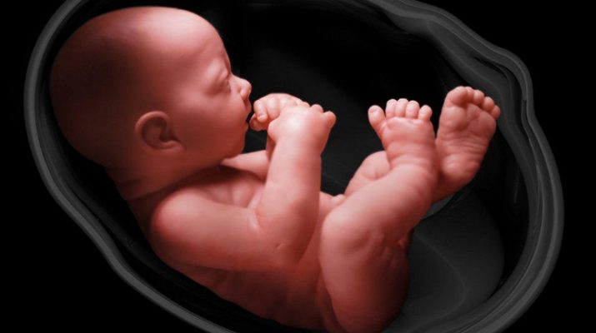

Slide 2
Defending Little Lives
Making a Case Against Abortion

Slide 3
To those considering abortion God says…

Slide 4
“Behold, children are a gift of the LORD, the fruit of the womb is a reward.” Psalm 127:3

Slide 5
“I call heaven and earth to witness against you today, that I have set before you life and death, the blessing and the curse. So CHOOSE LIFE in order that you may live, you and your descendants after you…” Deuteronomy 30:19

Slide 6
“There is a way that seems right to a man, but its end is the way of death.” Proverbs 14:12

Slide 7
“You shall not murder.” Exodus 20:13

Slide 8
To those called to defend life God says….

Slide 9
“Open your mouth for the speechless, in the cause of all who are appointed to die. Open your mouth and judge righteously, and plead the cause of the poor and needy.” Proverbs 31:8-9

Slide 10
“Deliver those who are drawn toward death, and hold back those stumbling to the slaughter. If you say, “Surely we did not know this,” Does not He who weighs the heart consider it? He who keeps your soul, does He not know it? And will He not render to each man according to his deeds?” Proverbs 24:11-12

Slide 11
“Pure and undefiled religion before God and the Father is this: to visit orphans and widows in their trouble, and to keep oneself unspotted from the world.” James 1:27

Slide 12
“And you shall love the Lord your God with all your heart, with all your soul, with all your mind and with all your strength. This is the first commandment. And the second commandment like it, is this: You shall love your neighbor as yourself.” Mark 12:30-31

Slide 13
Who are my little neighbors? What are they? What does God say? What does science say?

Slide 14
“God created man in His own image, in the image of God He created him; male and female He created them… and God said, “Be fruitful and multiply.” Genesis 1:27,28 Genesis 9:6

Slide 15
“Before I formed you in the womb I knew you. Before you were born I consecrated you; I have appointed you a prophet to the nations.” Jeremiah 1:5

Slide 16
“For you formed my inward parts, You wove me together in my mother’s womb. I will give You thanks for I am fearfully and wonderfully made. Marvelous are Your works, and that my soul knows very well.” Psalm 139:13-14

Slide 17
“Behold, the virgin shall be with child, and bear a Son, and they shall call His name Immanuel, which means, “God with us.” Matthew 1:23

Slide 18
“For he will be great in the sight of the Lord; and he will drink no wine or strong drink, and he will be filled with the Holy Spirit while yet in his mother’s womb.” Luke 1:15

Slide 19
“When Elizabeth heard Mary’s greeting, the baby leaped in her womb; and Elizabeth was filled with the Holy Spirit… And she said to Mary, “…the babe leaped in my womb for joy.” Luke 1:41,44

Slide 20
It is clear that the Word of God affirms the personhood and worth of every unborn child as made in the image of God.

Slide 21
What does science say?

Slide 22
“Every human embryologist in the world knows that the life of the new individual human being begins at fertilization. It is not belief. It is scientific fact.”
Dr. Ward Kischer, Human Embryologist, University of Arizona

Slide 23
There are no morally significant differences between the embryo you once were and the adult you are today. You have been the same person, with the same DNA, from the moment of your conception. The S.L.E.D. acronym helps show this to those who are pro-abortion.

Slide 24
S.L.E.D.
Defending the
humanity & personhood
of the unborn

Slide 25
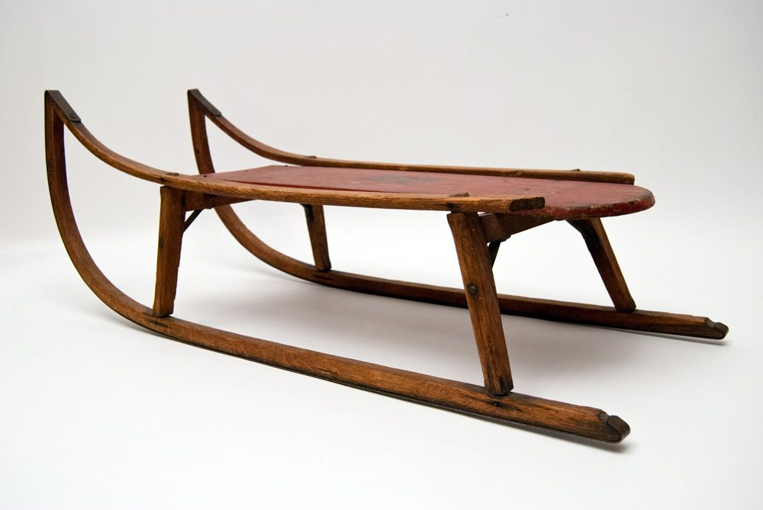
S.L.E.D.

Slide 26
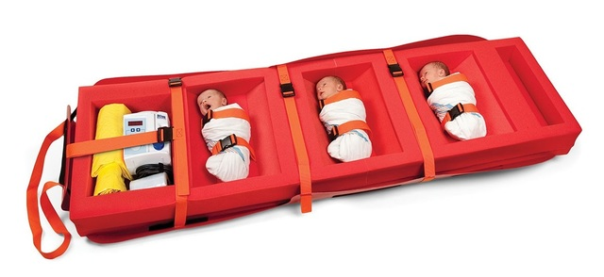
S.L.E.D.

Slide 27
S - Size L - Level of Development E - Environment D - Degree of Dependency
S.L.E.D.

Slide 28
S - Size A person’s size does not determine their value or worth. A 2 month old is smaller than 2 year old, who is smaller than 10 year old, but they’re all still people. The unborn are smaller, but they are still 100% human persons.
S.L.E.D.

Slide 29
L - Level of Development A person’s level of development doesn’t determine their value. A 4 year old has not developed as much as a teenager, but they are still 100% a human person. Children naturally progress through different stages of development & even if they are developmentally challenged it does not change their personhood.
S.L.E.D.

Slide 30
E - Environment Your location or environment does not change your value or what you are. Yes, the unborn are in a unique environment, but they are still human persons. If you were in outer space or scuba diving underwater, you’re personhood does not change.
S.L.E.D.

Slide 31
D - Degree of Dependency The unborn are certainly dependent on the mother’s body for nutrition and a proper environment. But newborns and toddlers are also dependent on others to give them nutrition and a safe environment. Personhood and worth does not change because someone depends on others. This also applies to handicapped, elderly, etc…
S.L.E.D.

Slide 32
S - Size L - Level of Development E - Environment D - Degree of Dependency
S.L.E.D.

Slide 33
North Carolina Abortion Facts In 2014 apx. 30,000 abortion divided by 37 clinics This Includes residents & out of state visitors Amounts to 3% of 1 million US abortions per year 400+ abortion a week in North Carolina Raleigh has over 100 abortions per week NC ABORTION LAWS No abortions after 20 weeks unless rape/incest/health? 72 hour waiting period after counsel about abortion Minors must have parental consent

Slide 34
WE MUST RISE UP AND DEFEND LIFE! 1- REPENT OF APATHY 2- PRAY FOR GOD TO MOVE 3- ACTIVELY ENGAGE

