Slide 1
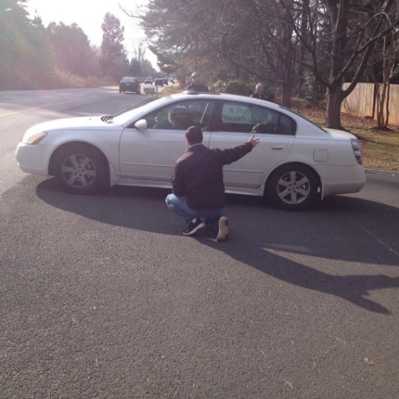
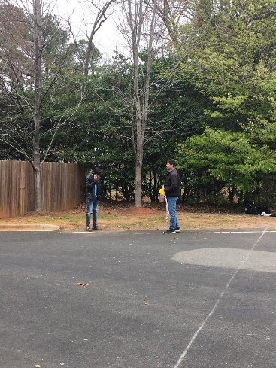
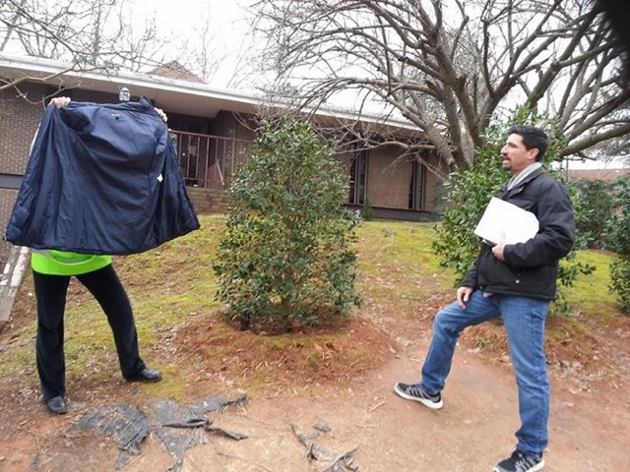
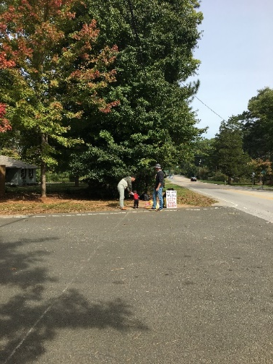
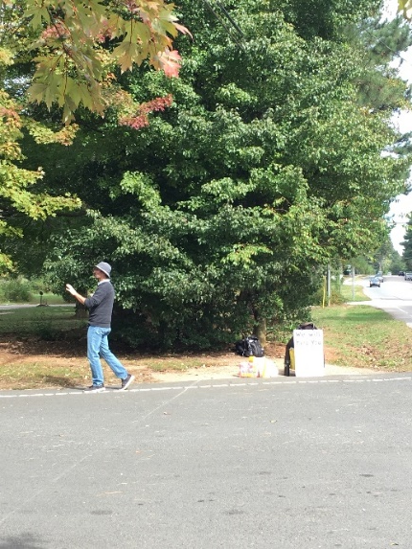
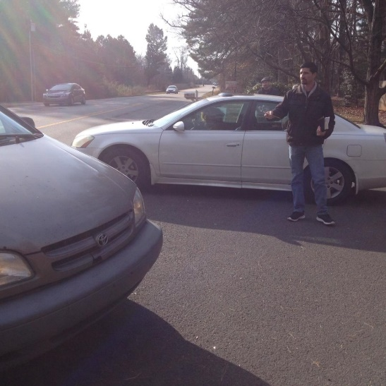
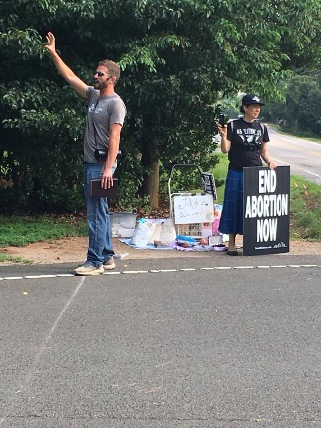
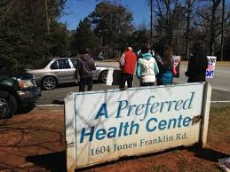
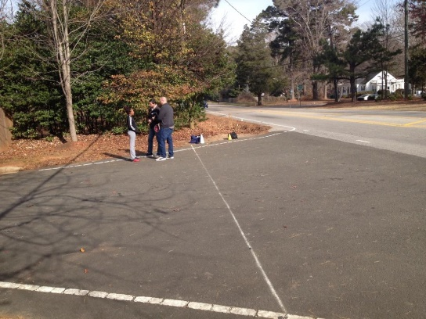
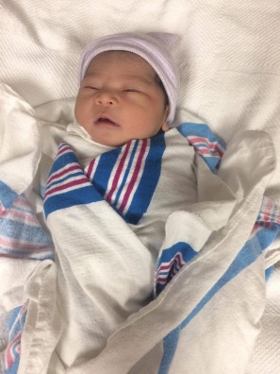
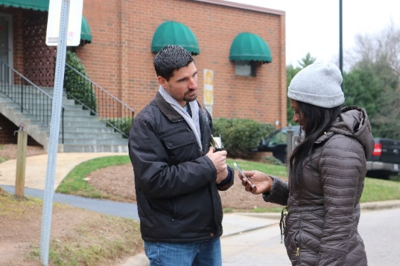
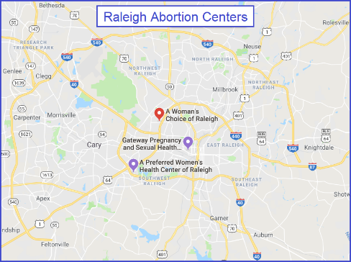
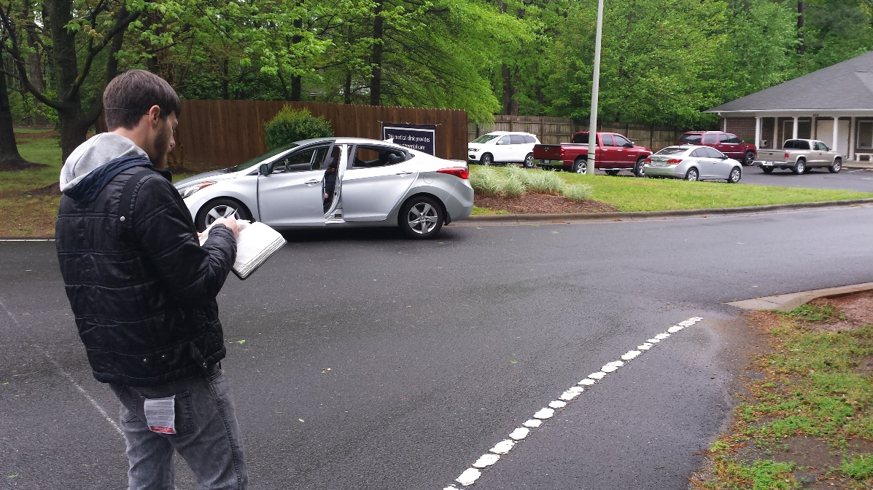
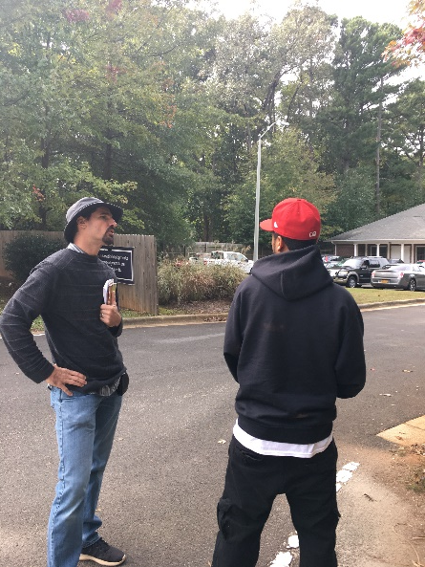
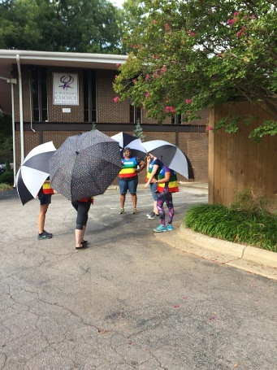
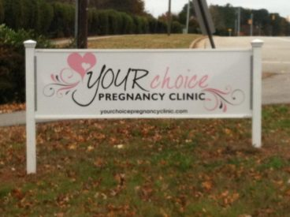
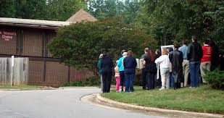
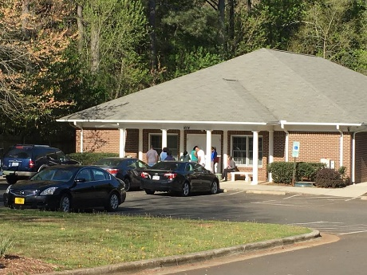
Raleigh Abortion Outreach

Slide 2
“Open your mouth for the speechless, in the cause of all who are appointed to die.” -Proverbs 31:8

Slide 3
2 Main Raleigh Abortion Centers

Slide 4
Abortion Center Outreach #1 Pray

Slide 5
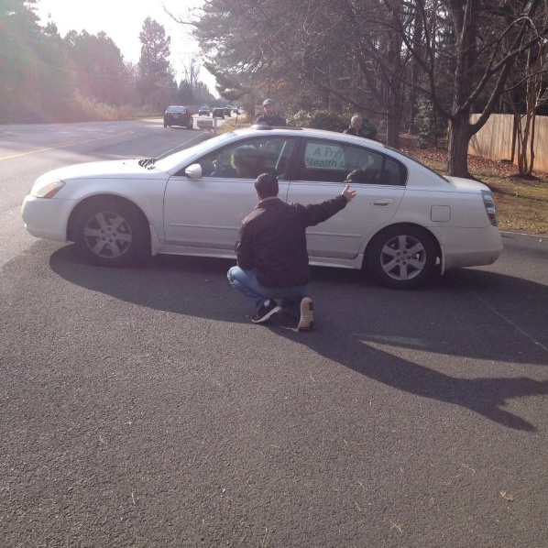
Abortion Center Outreach #2 Introduce Ourselves

Slide 6
Abortion Center Outreach #3 Hand Out Pro-Life Info

Slide 7
Abortion Center Outreach #4 Recommend Your Choice

Slide 8
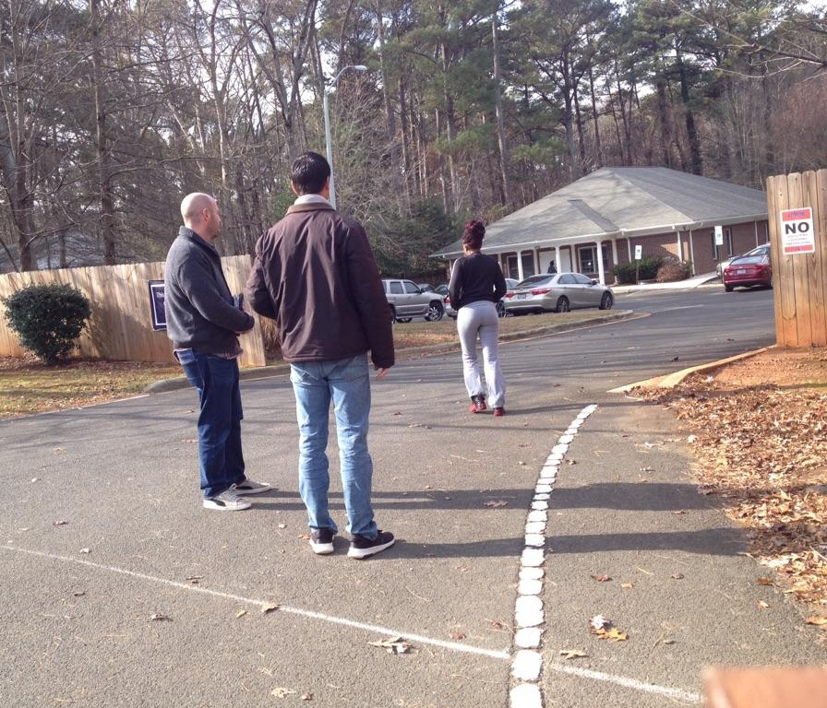
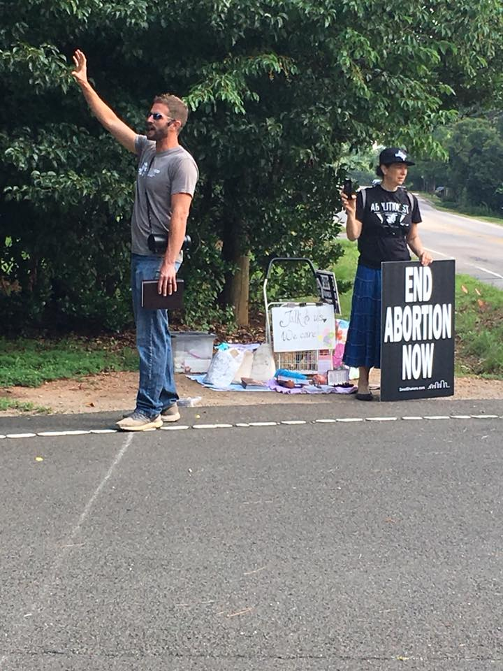
Abortion Center Outreach #5- Plead with moms

Slide 9
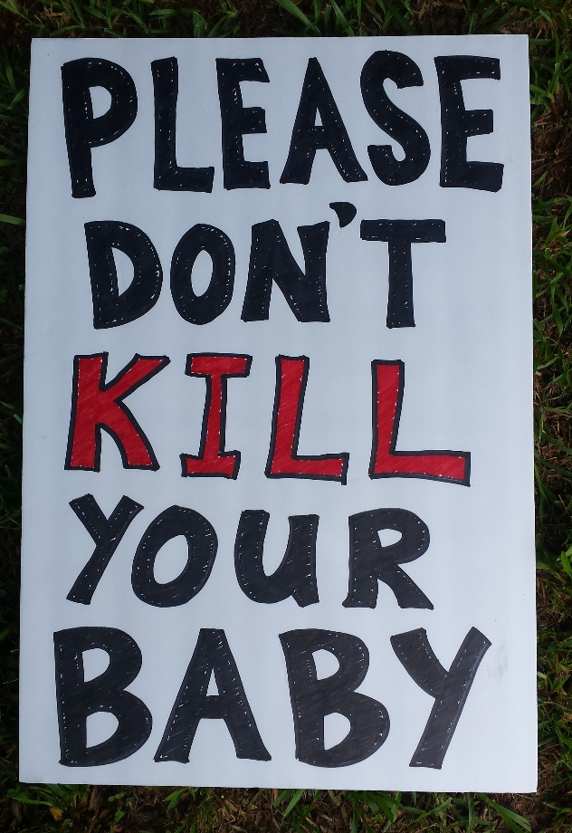
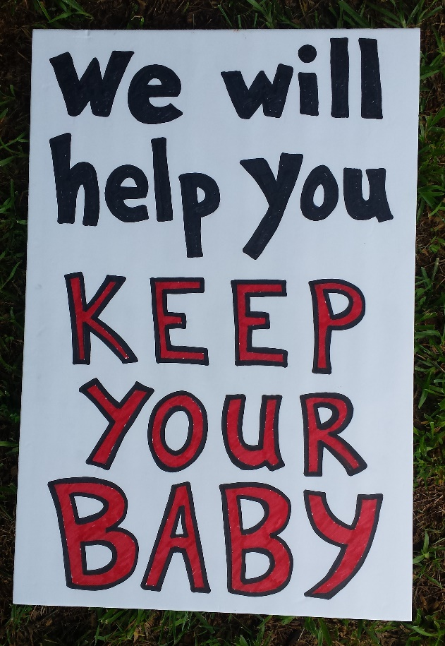
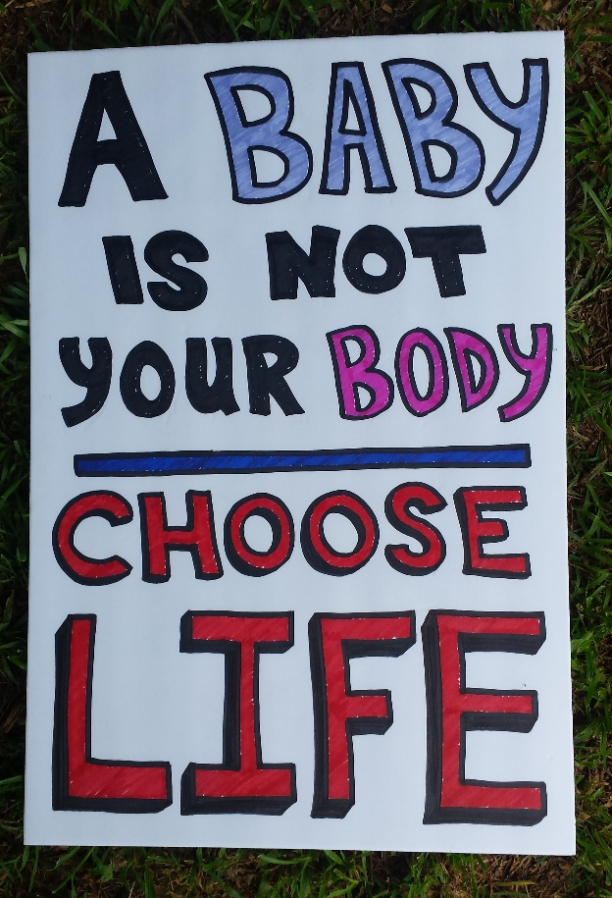
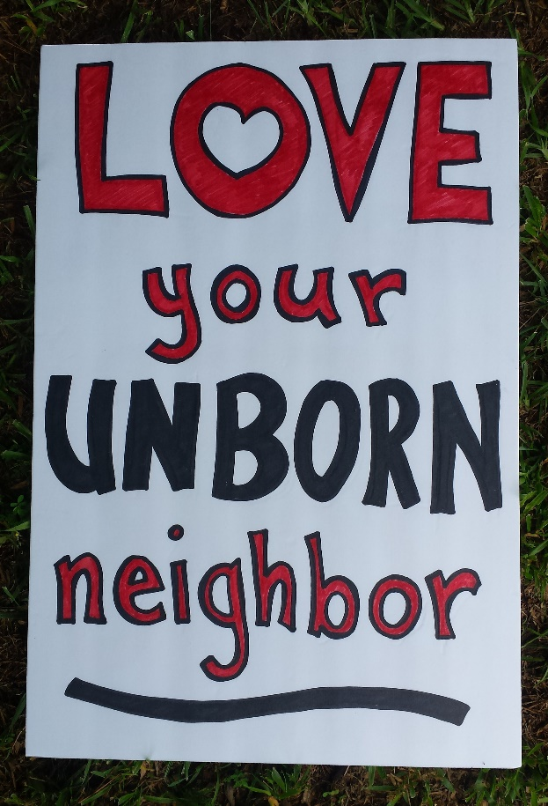
Abortion Center Outreach #6- Hold signs & pray

Slide 10
Abortion Center Outreach #7- Talk 1-2-1 with people

Slide 11
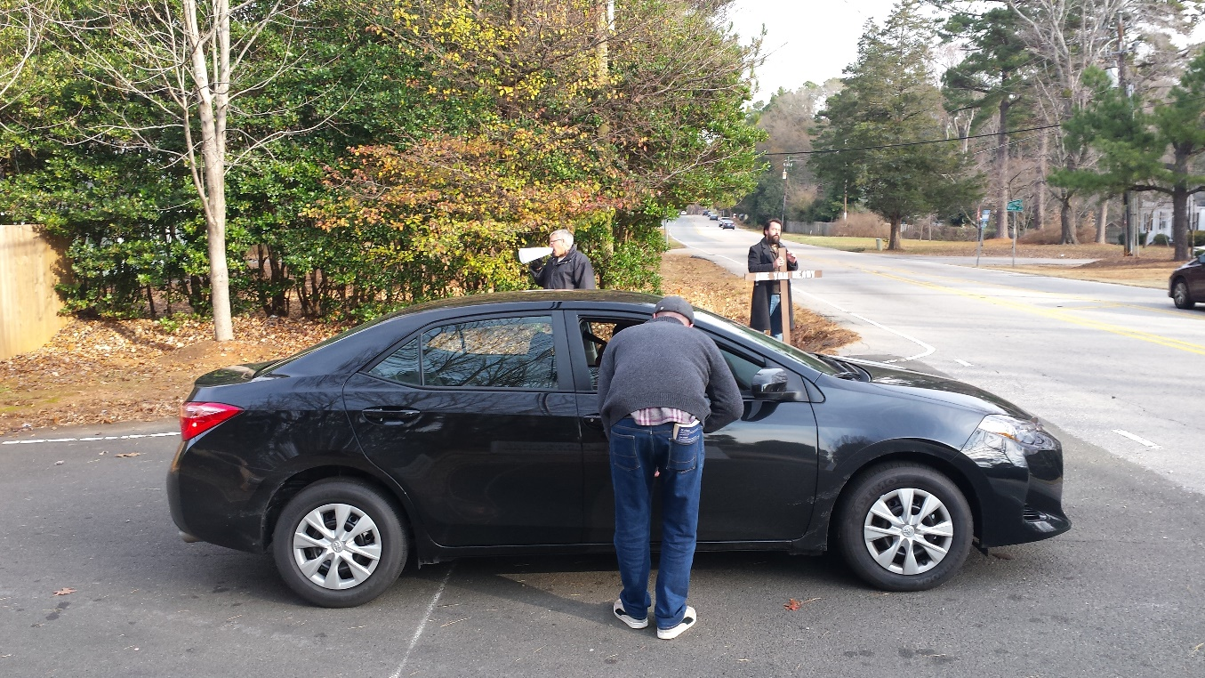
Abortion Center Outreach #8- Get contact info & follow-up

Slide 12
Why do you go to the abortion center? …for Joy Carlos! born Feb. 11, 2019

Slide 13
Francis Schaeffer said,
“Every abortion clinic should have a sign in front stating,
‘Open by the permission of the church.’”

Slide 14
Ways you can help: 1- Commit to LOVE LIFE week 2- Pray for the local outreach 3- Join the frontlines 4- Help with follow-up 5- Be bold & spread the word

Slide 15
Let’s End Abortion

