Slide 1
Abortion an unwanted history

Slide 2
Ancient Child Sacrifice and Modern Day Abortion
Exchanging one evil for another

Slide 3
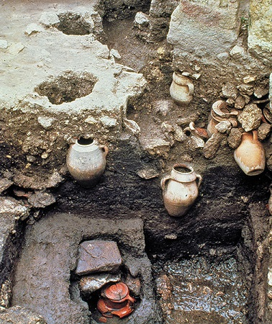
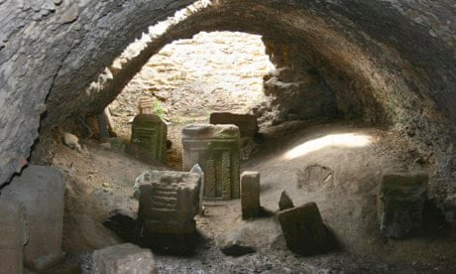
Ancient Carthage Cemetery of Sacrificed Infants

Slide 5
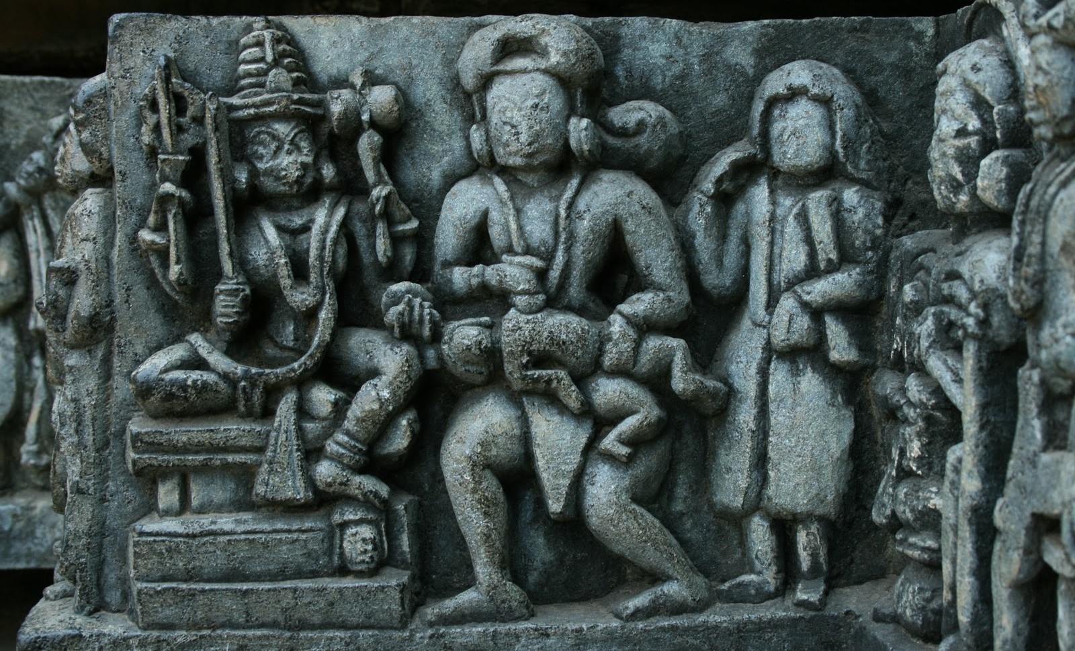
Canaanite Baal Worship & Child Sacrifice

Slide 6
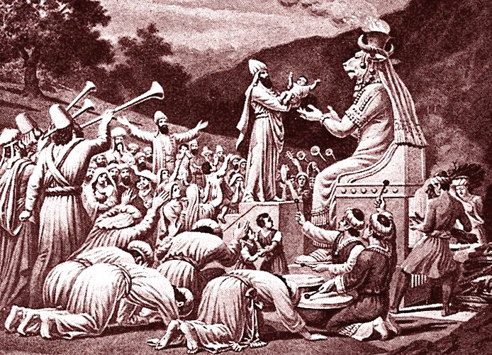
Moloch Worship & Child Sacrifice

Slide 7
What was Ancient Child Sacrifice?
1- Ancient pagan cultural cult practice of sacrificing new born babies or children as an offering or act of worship to a false god(s) for various reasons
2- Women would give their children to priests, and the priests would kill the child and then burn the child, or kill the child through burning
3- The child would roll down the arms of Moloch into the flames, as horns and drums playing in the background create a “worshipful” atmosphere and drown out the cries and screams of the children (and/or worshippers)
4- This kind of idolatry has been found in cultures centuries before Christ and even during the Roman empire

Slide 8
Who would offer Child Sacrifice?
1- Those involved in pagan prostitution and cult worship found child sacrifice as the easiest way to dispose of unwanted children
2- Women pregnant from adultery, fornication or prostitution
3- Men eager to dispose of unwanted children from adultery, fornication or prostitution
4- Worshippers seeking favor, gain or prosperity from a deity
5- Worshippers paying back a “deity” for receiving favor, success or victory from war
6- Community suffering from a crisis or seeking to avoid one

Slide 9
Why would they offer Child Sacrifice?
1- To dispose of unwanted children
2- To seek the favor of a deity(s)
3- Community mass sacrifices would proceed or follow a victory or defeat in war
4- Deformed children would be sacrificed in hope gaining a healthy child
5- The wealthy would buy poor children to sacrifice in place of their own

Slide 10
What does God say about Ancient Child Sacrifice?
Leviticus 18:21, 20:1-5, don’t burn kids b/c of sex or turn a blind eye
Deuteronomy 12:29-31, don’t be like pagan nations who burn kids
1 Kings 11:7-8, Solomon fell into sex worship & built Moloch hills(civil war)
2 Kings 16:3, Ahaz took on Israel’s rebellion and burned his son
2 Kings 17:17, Hoshea and Israel burned kids
2 Kings 18:3 Revival under Hezekiah in Judah, destroyed high places
2 Kings 21:1-6, *9 Manasseh burned his kid and was evil
2 Kings 22:2 Josiah restored Judah
2 Kings 23:1-*10 Josiah destroyed Tophet, Valley of the Son of Hinnom
Jeremiah 7:31-32/19:4-6/32:35 burning kids is not even in God’s mind
Jeremiah 18:5-11 if a nation repents God will show mercy
Ezekiel 16:20-21/ 23:37-*39 God says you killed His kids

Slide 11
Modern Day Abortion?

Slide 12
What is Modern Abortion?
1-The intentional termination of a pregnancy or the intentional killing of an unborn child
2- Pregnant women offer their unborn child to the abortion doctor to kill
3- The abortion doctor kills the child through dismemberment, burns the child with saline, or kills the child with abortion pills.

Slide 13
Who gets an Abortion?
1- Women who conceived a child through sexual sin, adultery or prostitution
2- Men & women who do not want a child
3- Men & women who want a better or healthy child
4- Women who are victims of rape or incest
5- Women who feel their health or wellbeing is in jeopardy
6- Women who feel pressured by a partner or family to get abortion
7- Women who use abortion as “contraception”

Slide 14
Why do women get an Abortion?
1- They feel that abortion will resolve their crisis
2- To escape the shame and reputation of being pregnant because of fornication, adultery, rape or incest.
3- To avoid missing out on education, success, career and independence
4- To protect their self-serving lifestyle and future
5- They feel pressure by the father who does not want to take responsibility and be a dad & so they’d feel alone as a mom
6- They do not want a child with the man who got them pregnant
7- Ignorant about the fact that abortion is the killing of an innocent child

Slide 15
What has the Church done in the past?
1- The Church established a God-centered respect for all human life
2- Church established a dignity of women, as not property of man, opposed cohabitation, and widows had rights
2- Church helped abolish infanticide in Rome & adopted unwanteds
3- Church helped to abolish the gladiator fights
4- Church helped emphasize monogamous marriage w/o infidelity, oppose polygamy
5- Church helped abolish the pagan widow burning practices, “Sati”
6- Church helped to abolish slavery
7- THE CHURCH WILL HELP END ABORTION!!!!

Slide 16
WE HAVE ONLY 2 OPTIONS AS A NATION:
JUDGEMENT
OR
REVIVAL

Slide 17
We Choose Revival!
1- Pray- Pray that God would begin to move mightily
2- Pure- We must walk in purity. Hypocrisy kills revival power
3- Preach- Preach the Gospel & Truth about LIFE boldly
4- Partner- Unite with other believers & combine our resources
5- Provide- Practically meeting real needs of hurting people

Slide 18
This LOVE LIFE week
1- HEAR………Today Sunday
2- PRAY………Wednesday Prayer & Fasting
3- GO………... Saturday Morning Drake Circle
4- CONNECT… Future Opportunities

Slide 19
Abortion an unwanted history
Much Insight drawn from the Article: “Abortion and the Ancient Practice of Child Sacrifice”
Non-Technical - Jan 05, 2012 - by Andrew White MD

